Slide 1




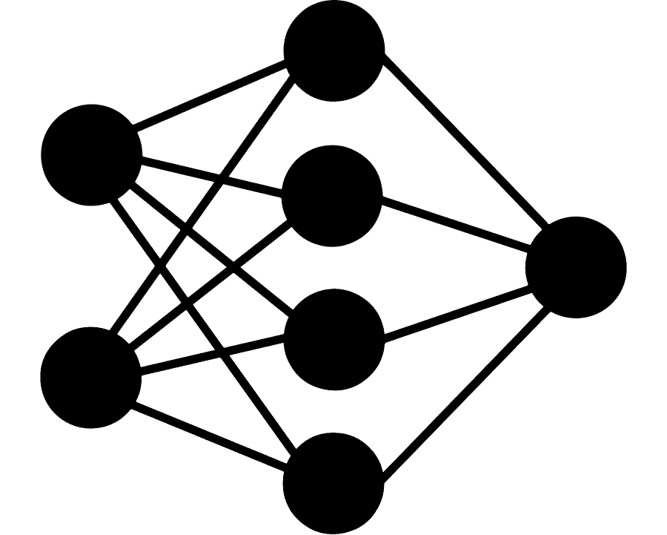
Building You Own Neural Network using Microsoft Excel: A Step-by-Step Guide
Presenter: Isham Rashik

Slide 2


Introduction about myself
Brought up in UAE - residing more than 27 years - from primary school till completing Masters.
BEng. Electrical And Electronic Engineer and MBA in Finance and Operations
Worked in multiple sectors - Education, Finance, Telecom, Media, and Research & Development
Currently working as AI Engineer working at KNAI.
Involved in both Classical Machine Learning and Generative AI projects
Overall more than 6 years in the field of State of the Art Technology
Top Voice in Machine Learning, Data Science and Artificial Intelligence on Linkedin from August 2023 till February 2024
Currently also AI Community lead under CodersHQ and one of the Co-Founders of Launchpad.

Slide 3









Slide 4
By end of the workshop, you will
Understand
Understand what neural networks are and the terminologies associated with it
Recognize
Recognize the key components that form neural networks
Hands on exp.
Get hands on with the Excel functions necessary for implementing forward propagation
Learn
Learn how to perform backward propagation using special add on tool in Excel
Appreciate
Appreciate the limitations of Excel for complex neural network applications
Develop
Develop a foundation for further exploration of more advanced neural network concepts

Slide 5
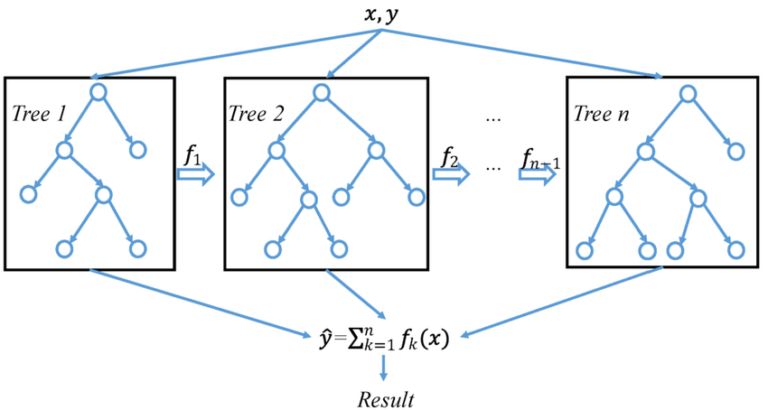
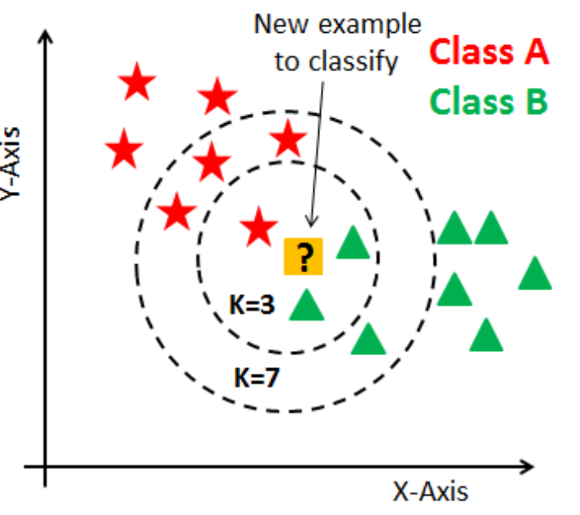
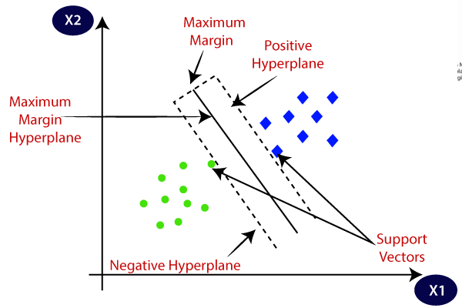
What are not Neural Networks?
Notes:
Key Distinctions of Neural Networks
Layered Structure: Multiple layers of interconnected nodes (neurons)
Non-linear Transformations: Each layer applies non-linear activation functions
Backpropagation: Learns by propagating errors backward through the network
Gradient Descent: Optimizes weights using gradients of the loss function
Feature Learning: Automatically learns relevant features from raw data
Scalability: Can handle extremely large and complex datasets
Flexibility: Adaptable to various types of data and problem structures

Slide 6
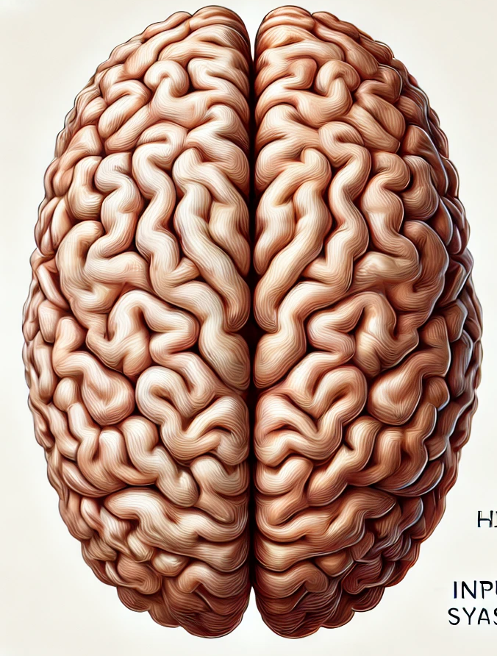
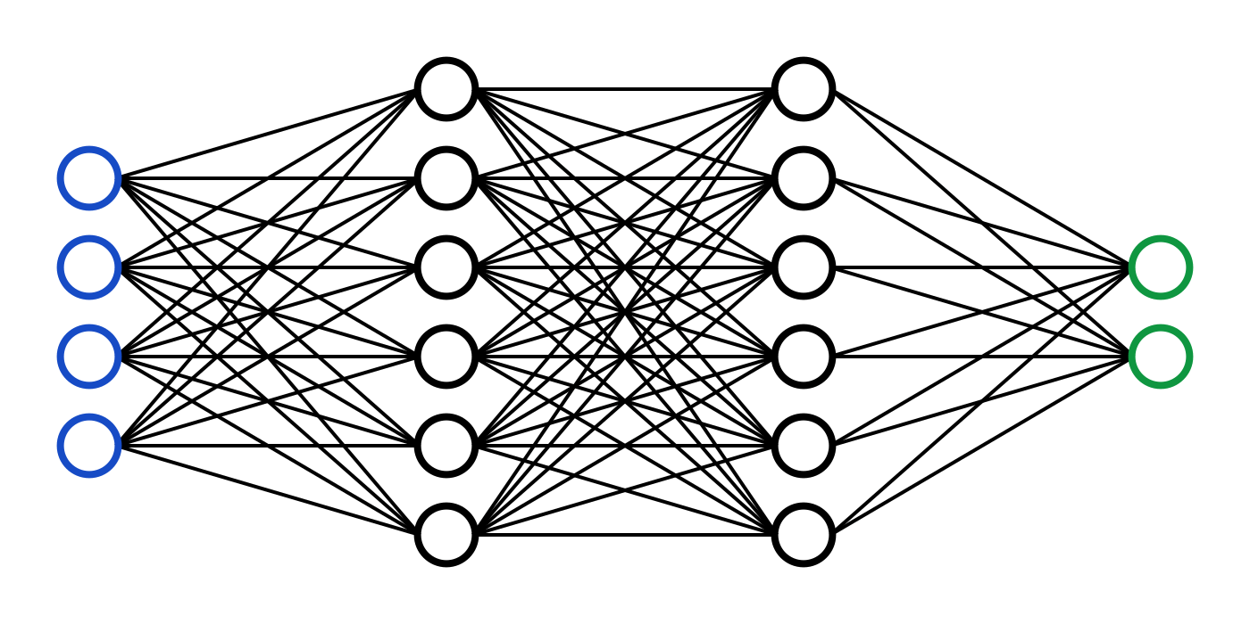
What are Neural Networks?
Notes:
A neural network is a method in artificial intelligence that teaches computers to process data in a way that is inspired by the human brain. It is a type of machine learning process, called deep learning, that uses interconnected nodes or neurons in a layered structure that resembles the human brain. It creates an adaptive system that computers use to learn from their mistakes and improve continuously. Thus, artificial neural networks attempt to solve complicated problems, like summarizing documents or recognizing faces, with greater accuracy.

Slide 7
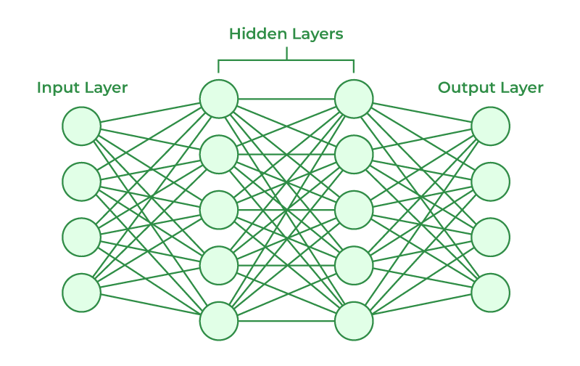
Key Components of Neural Networks

Slide 8
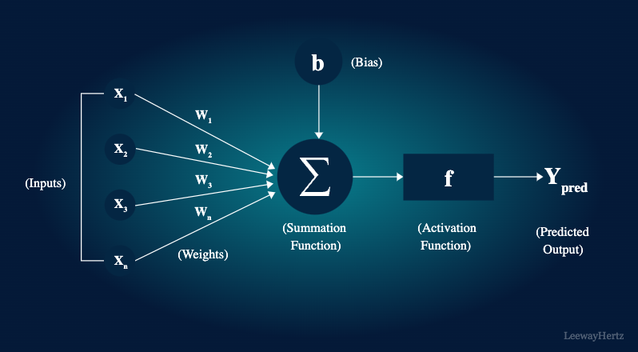
Key Components of Neural Networks - continuation

Slide 9
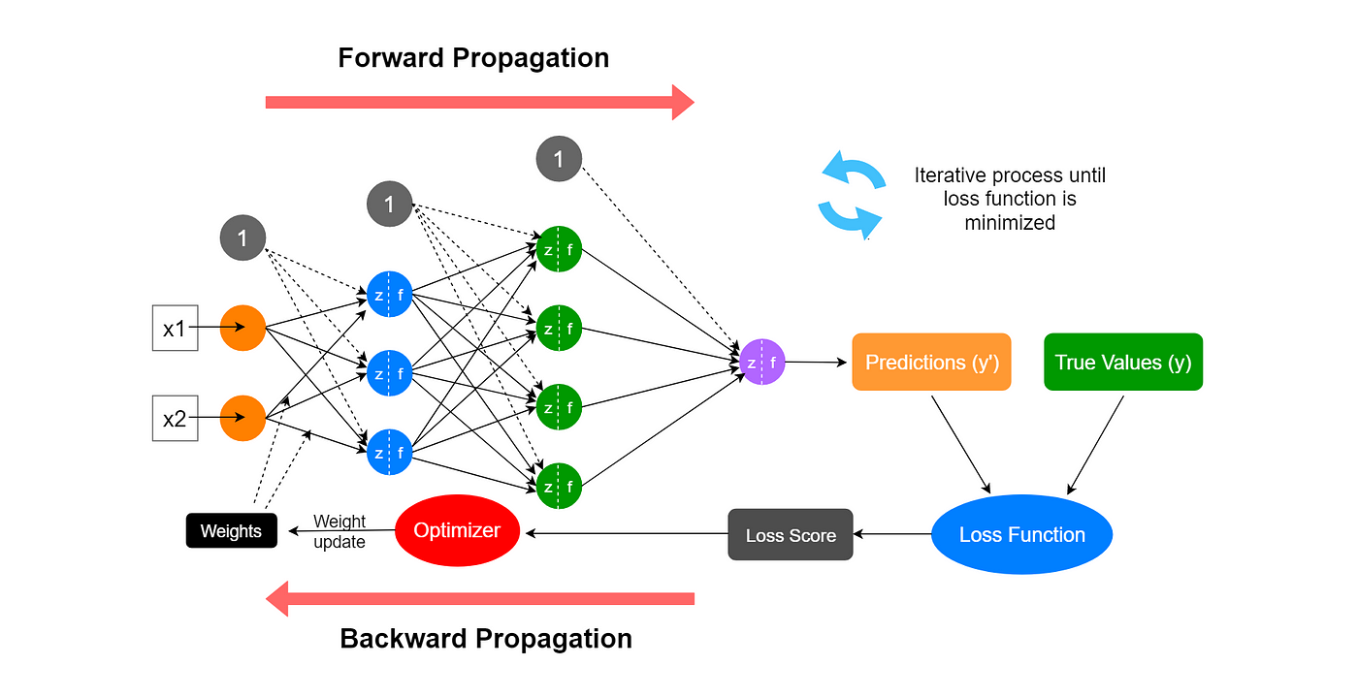
How Neural Networks work?

Slide 10


Demo on Excel

Slide 11
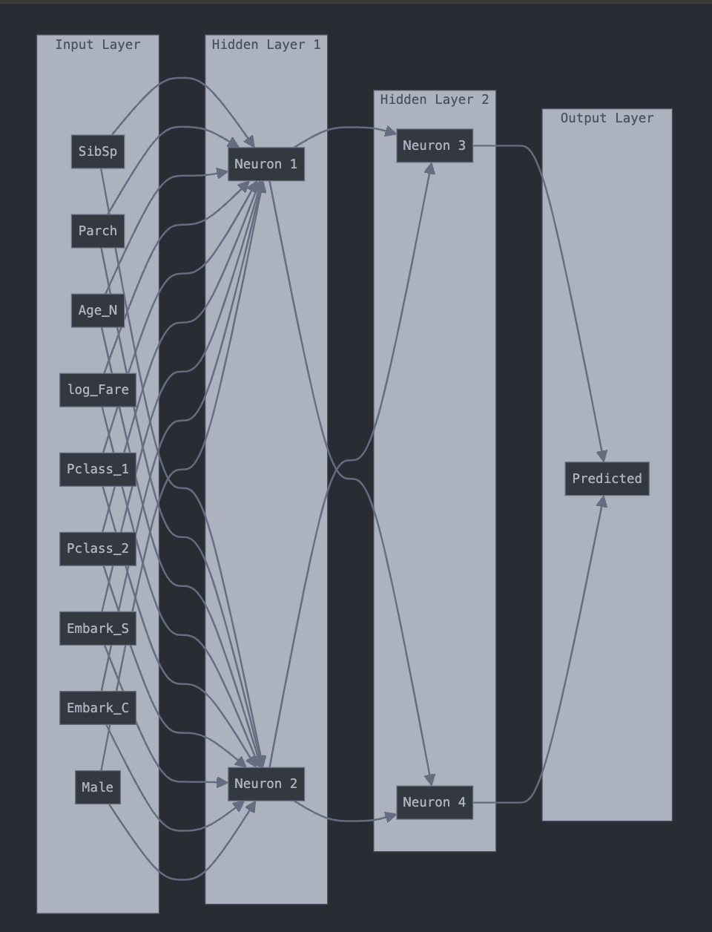
Exercise – Implement the following Neural Network in Excel

Slide 12

Limitations on Excel
Computation Power
Scalability Issues
Lack of Built-in Machine Learning Functions
Limited Optimization Techniques
Difficulty in Implementing Complex Architectures
Lack of GPU Support
Notes:
# Limitations of Excel for Neural Networks
While Excel is an excellent tool for learning the basics of neural networks, it has several limitations for more complex or practical applications:
1. **Computational Power**:
- Excel is not optimized for the heavy computations required by large neural networks.
- Training time increases exponentially with network size and dataset complexity.
2. **Scalability Issues**:
- Excel has row limitations (1,048,576 rows in Excel 2019), restricting dataset size.
- Complex networks with many layers or neurons quickly become unmanageable.
3. **Lack of Built-in Machine Learning Functions**:
- Unlike specialized libraries (e.g., TensorFlow, PyTorch), Excel doesn't have pre-built neural network functions.
- Implementing advanced algorithms (e.g., convolutional layers, LSTM) is extremely challenging.
4. **Memory Constraints**:
- Excel loads all data into RAM, limiting the size of usable datasets.
- Large neural networks can cause Excel to become slow or unstable.
5. **Limited Optimization Techniques**:
- Excel's Solver tool is basic compared to advanced optimization algorithms used in machine learning.
- Gradient descent implementations are manual and inefficient.
6. **Difficulty in Implementing Complex Architectures**:
- Creating and managing multi-layer networks becomes cumbersome.
- Implementing techniques like dropout, batch normalization, or attention mechanisms is impractical.
7. **Lack of GPU Acceleration**:
- Excel cannot leverage GPU processing, which is crucial for efficient neural network training.
8. **Version Control and Collaboration Challenges**:
- Tracking changes and collaborating on neural network models in Excel is difficult compared to code-based solutions.
9. **Limited Visualization Capabilities**:
- Excel's charting tools are basic compared to specialized data visualization libraries.
- Visualizing high-dimensional data or complex network architectures is challenging.
10. **Reproducibility Issues**:
- Ensuring consistent results across different Excel versions or operating systems can be problematic.
11. **Inflexibility for Experimentation**:
- Modifying network architecture or hyperparameters requires significant manual effort.
- A/B testing or ensemble methods are time-consuming to implement.
12. **Lack of Real-time Processing**:
- Excel is not suitable for applications requiring real-time predictions or online learning.

Slide 13

Why Building NN on Excel?
Accessibility and Familiarity
Transparency of Calculations
Immediate Feedback
No Coding Required
Gradual Complexity
Notes:
# Why Build Neural Networks in Excel?
## 1. Accessibility and Familiarity
- Excel is widely available and most people have some experience with it.
- Lowering the entry barrier to neural networks by using a familiar tool.
## 2. Transparency of Calculations
- Every step of the neural network process is visible in the spreadsheet.
- No "black box" – you can see exactly how inputs become outputs.
## 3. Understanding the Fundamentals
- Building from scratch forces us to understand each component.
- Gain insights into the math and logic behind neural networks.
## 4. Visual Representation
- Excel's grid structure naturally represents the layered structure of neural networks.
- Easy to visualize weights, biases, and neuron activations.
## 5. Immediate Feedback
- Changes to the network are reflected instantly.
- Encourages experimentation and hands-on learning.
## 6. No Coding Required
- Ideal for those who aren't comfortable with programming languages.
- Focuses on concepts rather than syntax.
## 7. Gradual Complexity
- Start simple and gradually add complexity.
- Easier to grasp one concept at a time.
## 8. Real-world Data Handling
- Excel's data manipulation features are useful for preprocessing.
- Learn about data preparation alongside neural network concepts.
## 9. Bridging to Advanced Tools
- Understanding Excel implementation makes transition to programming easier.
- Provides a foundation for learning libraries like TensorFlow or PyTorch.
## 10. Practical Limitations as Learning Opportunities
- Excel's limitations in handling complex networks become teachable moments.
- Understand why specialized tools are necessary for advanced applications.
While these limitations make Excel impractical for professional or large-scale neural network applications, it remains a valuable tool for educational purposes and understanding the fundamental concepts of neural networks. Remember, our goal is not to replace professional machine learning tools, but to demystify neural networks and build a strong conceptual foundation.

Slide 14




Future Work
After completing the exercise, try implementing logistic regression and apply sigmoid function for nn and change the loss function – binary cross entropy
Transition to Python – start with NumPy
Learn about other Deep Learning Algorithms – CNN, RNN, LSTM, Transformers
Deep Learning Frameworks – PyTorch and HuggingFace Transformers
Real-World Applications

Slide 15

The future of AI isn't just something you'll read about— it's something you can actively shape. Today’s understanding can be tomorrow’s innovation
Notes:
The Power of Understanding Neural Networks
- Foundation for Innovation
- Critical analysis of cutting-edge research
- Contribute to AI advancements
- Pathway to Breakthroughs
- Every algorithm starts with basics
- Your Excel model → Tomorrow's AI revolution?
- Your Challenge:
1. Dive deeper
2. Experiment boldly
3. Question continuously
"The future of AI isn't just something you'll read about—
it's something you can actively shape."
Remember: Today's understanding is tomorrow's innovation!

